Slide 1



Sustainability in Hotel Industry
Presenter: Dr. Ayon Bhattacharya
Environmental talk with Dr Ayon Bhattacharya
https://www.linkedin.com/in/ayon123/

Slide 2


Section 1
Building a Sustainable Foundation

Slide 3

Forming a Hotel Green Team
01
02
03
Diverse Team Composition
SMART Goal Setting
Engagement and Training
Establish specific, measurable, achievable, relevant, and time-bound objectives SMART Goals to guide the Green Team's initiatives, facilitating effective tracking of progress and accountability.
Include members from all hotel departments to leverage varied expertise, ensuring comprehensive sustainability strategies that address unique operational challenges and opportunities.
Implement regular training sessions for staff and interactive programs for guests to foster a culture of sustainability, enhancing participation and awareness of eco-friendly practices.

Slide 4
Defining Goals for Sustainability
Vision Communication Strategy
Develop a comprehensive communication plan to ensure that the sustainability vision is effectively shared across all levels of the organization, fostering a unified commitment to environmental and social responsibility among staff and stakeholders.
Stakeholder Feedback Mechanism
Implement a structured feedback system to gather insights from employees, guests, and local communities, allowing for continuous improvement of sustainability goals and ensuring alignment with stakeholder expectations and needs.
Regular Progress Reviews
Schedule periodic assessments of sustainability goals to evaluate progress, identify challenges, and adjust strategies as necessary, ensuring that the hotel remains responsive to evolving sustainability trends and technologies.

Slide 5
Strategies to Cut Wastage
Guest Participation Initiatives
Implementing Smart Technology
Integrating smart technology, such as energy management systems and automated water controls, can significantly reduce wastage. These systems monitor usage patterns and adjust resources accordingly, leading to enhanced efficiency and lower operational costs while promoting sustainable practices within the hotel environment.
Encouraging guests to participate in sustainability efforts, such as opting out of daily linen changes or using refillable toiletries, can greatly minimize resource consumption.
Providing incentives for participation not
only fosters a sense of community but also reinforces the hotel's commitment to reduce waste and promoting eco-friendly behaviors.

Slide 6




Encourage Reuse and Recycling
Structured Recycling Initiatives
Incentivizing Reusable Practices
Community Engagement and Partnerships
Establish comprehensive recycling programs with clearly labeled bins and educational materials to guide guests and staff on proper recycling practices, enhancing overall participation and effectiveness.
Promote the use of reusable items, such as glass bottles and cloth napkins, by providing incentives for guests, thereby reducing waste and reinforcing sustainable habits during their stay.
Collaborate with local recycling organizations and charities to enhance sustainability efforts, facilitating effective recycling programs and supporting community initiatives through food donations and resource sharing.

Slide 7
Section 2
Implementing Eco-Friendly Practices

Slide 8
Water Conservation Techniques
01
02
03
Innovative Water Management
Guest Engagement Programs
Regular Maintenance Checks
Implementing advanced water management systems can optimize usage, ensuring that every drop is utilized efficiently while minimizing waste across hotel operations.
Actively involving guests in water conservation efforts through informative signage and participation incentives can enhance awareness and promote responsible water usage during their stay.
Conducting routine inspections of plumbing and irrigation systems can prevent leaks and inefficiencies, ensuring that water conservation measures remain effective and sustainable over time.

Slide 9
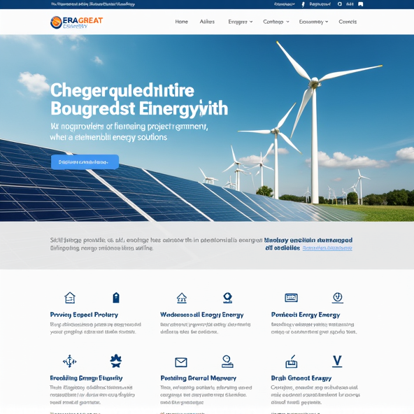
Energy Efficiency Measures
Comprehensive Energy Management Systems
Implementing advanced energy management systems enables hotels to monitor and control energy usage in real-time, facilitating data-driven decisions that optimize energy consumption across all operations, ultimately leading to significant cost savings and enhanced sustainability.

Slide 10

Sustainable Furnishings and Amenities
Eco-Conscious Material Sourcing
Prioritize the use of furnishings made from renewable resources, such as FSC-certified wood and recycled metals, to significantly lower environmental impact while enhancing the aesthetic appeal and durability of hotel interiors.

Slide 11
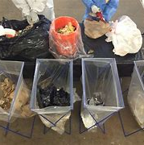
Waste Management Solutions
Comprehensive Waste Audits
Conducting regular waste audits allows hotels to analyze the types and volumes of waste generated, enabling targeted strategies for reduction, recycling, and composting, ultimately enhancing sustainability efforts and operational efficiency.

Slide 12
Section 3
Enhancing Operational Sustainability

Slide 13



Sustainable Sourcing and Local Partnerships
Local Economic Empowerment
Cultural Authenticity in Offerings
Sustainability Marketing Advantage
Engaging local suppliers not only strengthens community ties but also stimulates the local economy, ensuring that financial resources circulate within the community and support local livelihoods.
Incorporating locally sourced products enhances the authenticity of hotel experiences, allowing guests to connect with the region's culture through food, crafts, and services that reflect local traditions.
Hotels that prioritize sustainable sourcing can effectively market themselves as eco-friendly destinations, attracting environmentally-conscious travelers and differentiating themselves in a competitive hospitality market.

Slide 14
Transportation and Guest Mobility Options
Sustainable Transportation Partnerships
Enhanced Guest Mobility Programs
Implementing comprehensive mobility programs that include shuttle services, e-bike rentals, and walking tours can significantly improve guest experiences. By providing easy access to sustainable transportation options, hotels not only promote environmental responsibility but also enrich the overall travel experience, fostering a deeper connection with the local community.
Establishing collaborations with local transportation services can enhance guest mobility while promoting eco-friendly options. By offering discounts or passes for public transit, hotels can encourage guests to utilize buses and trains, reducing reliance on personal vehicles and minimizing overall carbon emissions during their stay.

Slide 15

Regular Energy Audits and Monitoring
Continuous Improvement Framework
Establish a structured framework for ongoing energy audits and monitoring that integrates feedback loops, allowing hotels to adapt and refine energy management strategies based on real-time data and evolving sustainability goals.

Slide 16
Checklist
Continuous Improvement Framework
50 pointer checklist to refer

Slide 17


Questions ???
Connect: Anjana Bhattacharya +91-8010088149
Website –Aanksh Hospitality – The one-stop solution for Hotels and Services
Email – info@aankshhospitality.com

